Slide 1

Residents’ views about active travel in Doncaster
CFE Research

Slide 2
Contents
These slides contain the findings from the Residents’ Panel survey conducted in July 2021.
The survey was completed by 146 residents.
The findings cover:
The characteristics of those responding to the survey
Active travel levels amongst residents in the last 3 months compared to the period between January to March 2021
Influencing factors for active travel
Where residents actively travel to
Impact of active travel
Preferred methods of transport
Perceptions about physical activity and active travel
Residents’ future plans for physical activity for travel and leisure
Key insights from the survey

Slide 3
Demographic characteristics

Slide 4
Demographics of respondents
Age | Number of respondents
16-24 | 13
25-44 | 62
45-64 | 48
65+ | 23
Disability | Number of respondents
No disability, mental health or illness | 82
Yes, but no substantial impact on daily life | 25
Yes, has substantial impact on daily life | 38
Prefer not to say | 1
Main employment status | Number of respondents
Employee full-time | 45
Employee part-time | 24
Self-employed | 10
Retired | 24
Unemployed and seeking work | 10
Student | 7
Not in work and looking after home or family | 11
Long-term sick | 15
Other economic activity | 0
Gender | Number of respondents
Male | 49
Female | 97
Ethnicity | Number of respondents
White British | 132
BAME | 14

Slide 5
Demographics of respondents
Income | Number of respondents
Low income | 68
Other income | 69
Unknown | 9
Household composition | Number of respondents
One or more adults, no children | 86
One adult with one or more children aged under | 18
Two or more adults with one or more children aged under | 42
In an Active Communities area | Number of respondents
Yes | 46
No | 100
Physical activity level when joined the panel | Number of respondents
Physically inactive | 39
Physically active at least once a week | 107

Slide 6
Active travel in the last 3 months

Slide 7
Residents’ active travel in the last 3 months
More residents have walked, jogged or run, and have done so more regularly, compared with cycling:
  8 in 10 (81%) residents have undertaken a short walk, jog or run to travel somewhere compared to just 2 in 10 (20%) for cycling. In addition, over 3 in 10 (35%) have undertaken a short walk, jog or run at least 4 times a week compared with just 3% for cycling.
  7 in 10 (73%) residents have undertaken a longer walk, jog or run to travel somewhere compared with just 2 in 10 (17%) for cycling and again they do it more regularly.
  Rates are similar to those reported by residents in the August 2020 active travel poll.
Proportion undertaking activity
Q1. In the last 3 months, how often did you do the following? N=146

Slide 8
Comparing active travel over the last 3 months with the period January to March 2021
  Over 7 in 10 (75%) residents had not undertaken a bike ride to travel somewhere across both periods of time, compared with just 2 in 10 (18%) residents who had not walked, jogged or run for travel purposes.
  Increases in active travel between the two time periods were more frequent for walking, jogging or running (27%) when compared to cycling (5%).
  More active community residents (49%) had increased the amount of walking, running or jogging they had done for travel in the last 3 months compared with non active community residents (28%).
  Although increases were more common, some had decreased the amount they actively travelled.
Q1. Reflecting on walking, jogging, running or cycling as a means of transport, how does the amount you undertook in the last 3 months compare to the period January to March 2021? N=146

Slide 9
Influencing factors for walking, jogging and running for travel

Slide 10
What influenced residents to maintain or increase walking, jogging or running for travel?
Keeping fit and healthy (56%) and because they enjoy it (48%) are the primary reasons that residents have maintained or increased the amount they walk, jog or run for travel in the last 3 months.
3 in 10 residents have maintained or increased this behaviour because it is convenient and approximately 2 in 10 have done so because they have more time to get to places (17%) and to help maintain social distancing due to the COVID-19 pandemic (16%).
There being ‘no alternatives available’ is only a reason for a small proportion of residents alongside it being more cost effective; therefore, most are choosing this as a method of travel.
Q3. What are the main reasons you have increased or maintained the amount of walking, jogging or running to travel somewhere in the last 3 months? N=90

Slide 11
What influenced residents to decrease walking, jogging or running for travel?
Of the small proportion who had decreased the amount of walking they do for travel 8 residents stated they did so because of health concerns, illness or disability; and 8 did so because they had lost their motivation.
No participants reduced this behaviour because they no longer enjoy walking, jogging or running for travel.
Q4. What are the main reasons you have decreased the amount of walking, jogging or running to travel somewhere in the last 3 months? N=25

Slide 12
Why have some residents undertaken no walking, jogging or running for travel since January 2021?
Of the small proportion who had undertaken no walking most (13) had not done so because of health concerns, illness or disability.
5 stated they did not think it was a convenient mode of transport and 4 had not done so because they did not want to/prefer alternative modes of transport.
Q5. What are the main reasons you have undertaken no walking, jogging or running to travel somewhere since January 2021? N=21

Slide 13
Influencing factors for cycling for travel

Slide 14
What influenced residents to maintain or increase cycling for travel?
Only 15 residents had maintained or increased the amount of cycling they had done for travel in the last 3 months (due to the low levels reported overall).
The most common reason was because they wanted to keep fit and healthy.
Enjoying it, because it’s more cost effective, and because it is a convenient way to get to places were also the more common reasons for doing so.
Q6. What are the main reasons you have increased or maintained the amount cycling to travel somewhere in the last 3 months? N=25

Slide 15
What influenced residents to decrease cycling for travel?
Of the low number of residents who reported a decrease not having the time that they did between January to March 21, and no longer owning or having access to a bike were the most common reasons.
As with walking, jogging or running for travel, no residents had reduced their cycling for active travel because they no longer enjoy it.
Q7. What are the main reasons you have decreased the amount of cycling to travel somewhere in the last 3 months? N=12

Slide 16
Why have some residents undertaken no cycling for travel since January 2021?
The most common reason for residents not cycling anywhere to travel, is because they do not own or have access to a bike, (53%).
3 in 10 (29%) residents have not done so because of health concerns, illness of disability.
Just over 1 in 10 (13%) are unable to ride a bike.
Q8. What are the main reasons you have undertaken no cycling to travel somewhere since January 2021? N=94

Slide 17
Where are residents travelling to when undertaking active travel?

Slide 18
Where residents have travelled to when walking, jogging or running
Residents are most likely to have walked, jogged or run to the shops in the last 3 months – this has increased from 56% to 76%.
Many also walk to a park or outdoor space and to the homes of friends and family.
Q9. Where did you walk, jog or run in the period between January to March 2021 and in the last 3 months?

Slide 19
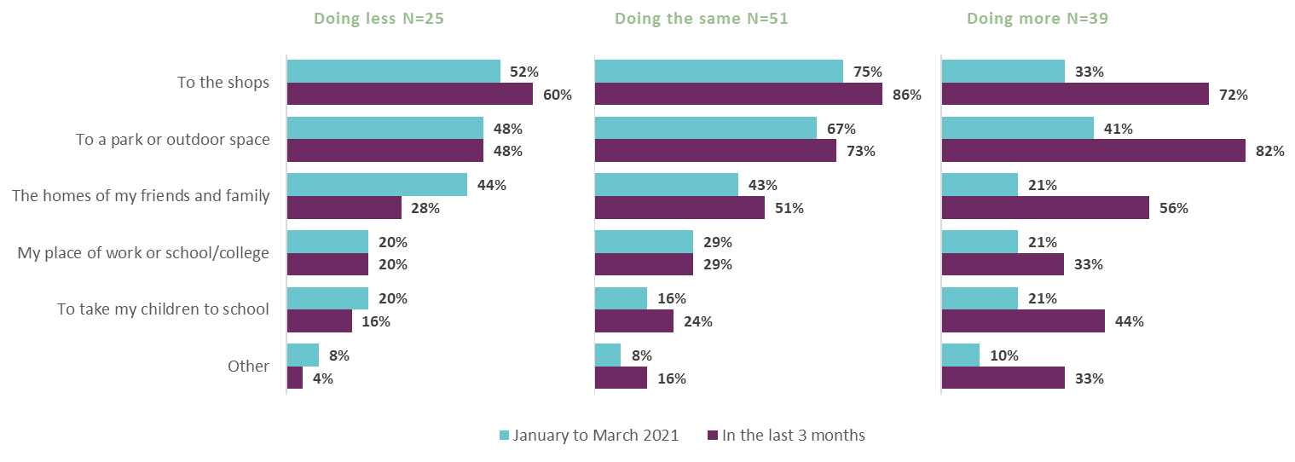
Where residents have travelled to when walking, jogging or running
Residents who have walked, jogged or run for travel purposes ‘more’ over the last 3 months, are now more commonly doing so for various reasons such as going to the park, shops, to visit friends and family or take children to school.
Q9. Where did you walk, jog or run in the period between January to March 2021 and in the last 3 months?

Slide 20
Where residents have travelled to when cycling
Across all 3 groups, residents most commonly cycled to shops, parks or outdoor spaces and to the homes of their family and friends.
Q10. Where did you cycle in the period between January to March 2021 and in the last 3 months?

Slide 21
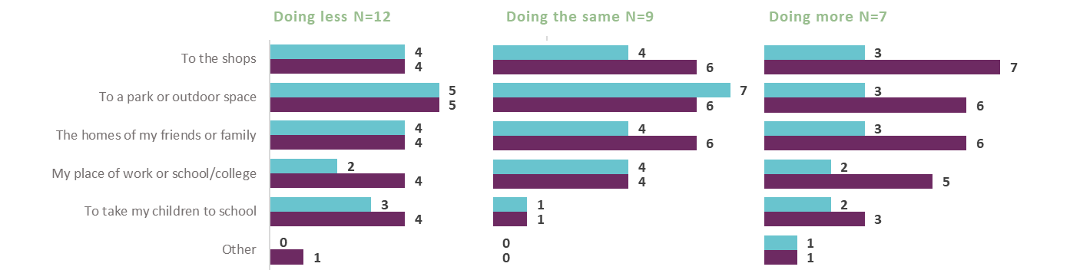
Where residents have travelled to when cycling
Given the group sizes, the patterns here are slightly less clear when split by the change in frequency.
Residents who have cycled more in the last 3 months, have generally increased the variety of places they are cycling to with the shops, the park, friends and family, and work/school or college featuring.
Q10. Where did you cycle in the period between January to March 2021 and in the last 3 months?

Slide 22
Impact of active travel on residents

Slide 23
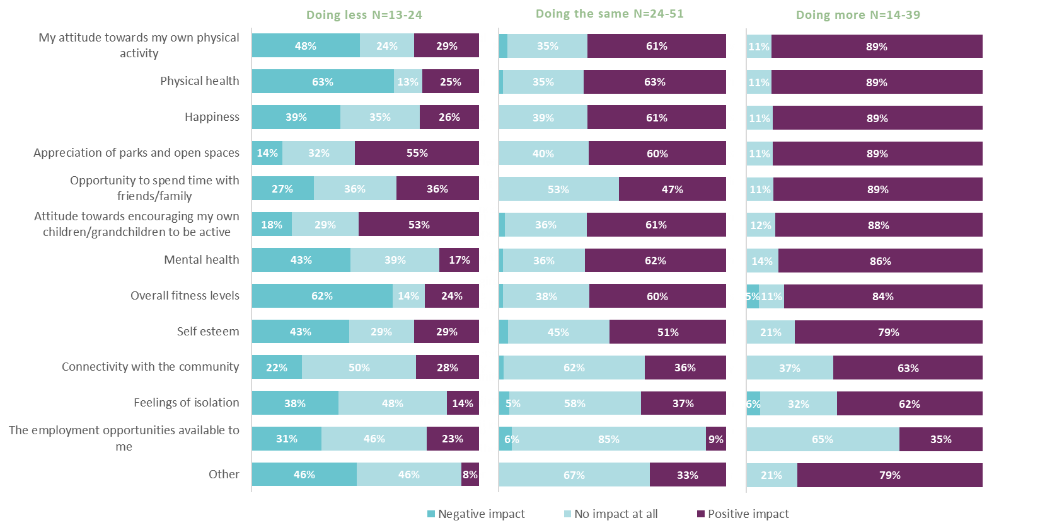
Impact of walking, jogging and running for travel
Encouragingly, those who have walked, jogged or run more for travel in the last 3 months have experienced a range of positive impacts as a result of doing so. This is similar for those who have done the same amount.
Those who have done less, generally report that it has had either a negative impact or no impact. Interestingly, over half of these residents report a positive impact on their appreciation of parks and open spaces and their attitude towards encouraging their own children/grandchildren to be active.
Q11. How has undertaking more/the same amount of/less walking, jogging or running to travel somewhere affected you?

Slide 24
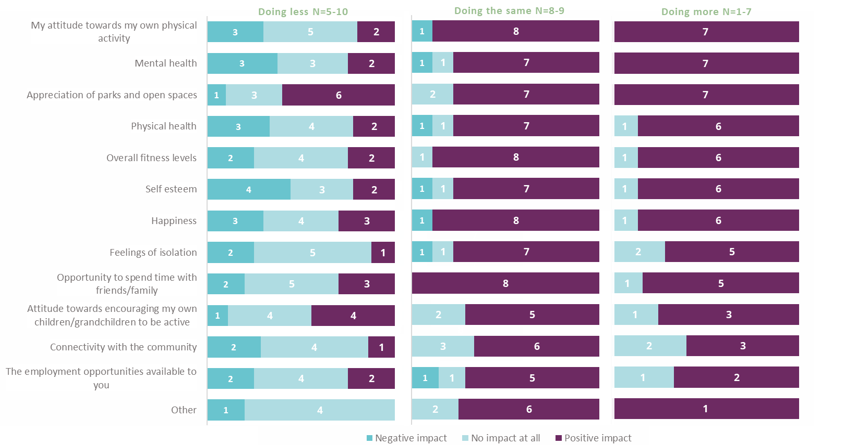
Impact of cycling for travel
Again, those who cycled more or maintained their levels in the last 3 months have experienced a range of positive impacts.
Those who have done less, generally report that it has had either a negative impact or no impact. Again, approximately half of these residents report a positive impact on their appreciation of parks and open spaces and their attitude towards encouraging their own children/grandchildren to be active.
Q11. How has undertaking more/the same amount of/less cycling to travel somewhere affected you?

Slide 25
Preferred modes of transport

Slide 26
Residents’ preferred modes of transport
Residents attitudes towards different modes of transport have changed since the COVID-19 pandemic.
Encouragingly, 6 in 10 residents (61%) now prefer to travel by foot (walking) compared with 5 in 10 (47%) before the pandemic.
Only approximately 2 in 10 residents prefer to travel by bus (21%) or train (16%) now, compared with 4 in 10 before the pandemic (42% and 37%, respectively).
However, travelling by car was the most common preferred mode of transport and still is.
Travelling by bike is still not a preferred mode of transport for many residents.
Q12. What were your preferred ways of travelling to reach places before the COVID-19 pandemic and what are they now? N=146

Slide 27
Perceptions about active travel

Slide 28
Motivators of active travel
Being physically active is important for over 7 in 10 (76%) residents, and over 6 in 10 (64%) enjoy active travel.
  More active community residents (24%) strongly disagree (providing a score of 0-2) that they enjoy walking, jogging or running for leisure compared with non active community residents (9%). In addition, fewer active community residents (29%) strongly agree (providing a score of 8-10) that being physically active is important to them compared with non active community residents (54%).
Encouragingly, over 7 in 10 (73%) of residents believe individuals have a responsibility to make greener transport choices in their daily lives, and 5 in 10 (51%) think they need to undertake active travel more to benefit the environment.
Proportion agreeing
Q13. To what extent do you agree or disagree with the following statements about walking, jogging, running or cycling to travel somewhere?

Slide 29
Barriers to active travel
Almost 8 in 10 (77%) residents agree that convenience is the main factor when considering how they travel to reach places. Over 7 in 10 (75%) agree that they are more likely to actively travel when the weather is better.
Interestingly, over 5 in 10 (56%) residents agree that they lack confidence on a bike.
  More females (45%) strongly agree (providing a score between 8-10) than males (25%).
4 in 10 (43%) residents agree they are not motivated to undertake active travel.
  More active community residents (36%) strongly agree (providing a score between 8-10) compared with non active community residents (19%).
  Over 2 in 10 (23%) residents agree that nothing would encourage them to undertake active travel (although some do currently actively travel whilst others have health problems which prevent them).
Proportion agreeing
Q13. To what extent do you agree or disagree with the following statements about walking, jogging, running or cycling to travel somewhere?

Slide 30
Infrastructure for active travel
Over 7 in 10 (71%) residents agree that improving the walking and cycling environment should be a priority in Doncaster.
Over 6 in 10 (65%) residents agree that roads in Doncaster are too dangerous to cycling and over 5 in 10 (54%) residents agree that pavements and walking environments in Doncaster are inadequate.
Just under 5 in 10 (49%) residents agree that public transport networks in Doncaster are fit for purpose.
Proportion agreeing
Q13. To what extent do you agree or disagree with the following statements about walking, jogging, running or cycling to travel somewhere?

Slide 31
Future plans

Slide 32
Residents’ plans for active travel and leisure/sport
Residents are overwhelmingly more likely to walk, jog or run for active travel or leisure in the next 3 months than they are to cycle reflecting their previous habits.
Despite a high proportion of residents definitely or possibly planning to undertake a walk, jog or run for active travel of leisure purposes, more residents in activity communities do not intend to do these things:
  22% of active community residents do not intend to undertake a short walk, jog or run for travel compared with 7% of non active community residents.
  35% of active community residents do not intend to undertake a longer walk, jog or run for travel compared with 19%.
  26% of active community residents do not intend to walk, jog or run for leisure compared with 11%.
Proportion planning to do activity
Q14. In the next 3 months, do you intend to do any of the following? N=146

Slide 33
Key insights

Slide 34
So, what does this mean?
Residents in Doncaster are more likely to walk, jog or run for both active travel and leisure than they are to cycle. Levels of active travel have remained similar to those reported in august last year.
Most residents have a positive attitude towards being physically active – but not all. They agree it is important to them, they enjoy it and they also think that individuals have a responsibility to make greener transport choices in their daily lives. However, residents from active communities enjoy it less, it is less important to them and they are less motivated to do it.
In the last 3 months, almost 3 in 10 residents have increased the amount of walking, jogging or running they have done to travel, which was mainly to help them keep fit and healthy and because they enjoy it. Encouragingly, there was a greater increase amongst active community residents. However, over 8 in 10 residents have undertaken no cycling for travel since January 2021. The main reasons for this are because residents do not own or have access to a bike; because of health concerns, illness or disability; or because they are unable to ride a bike.
Residents have most commonly actively travelled in the last 3 months to go to the shops, visit a park or outdoor space, or visit the homes of their friends and families. These trends were also the same for the period between January to March 2021, but fewer residents reported doing so. Residents who have increased their active travel in the last 3 months are now undertaking active travel for a wider variety of reasons than those who have maintained their activity or those who have reduced it. For example, they are now also undertaking more active travel to go to the shop, get to work or school/college, and to take their children to school more so than those who have maintained their active travel levels or those who are doing less. These changes align with changes to COVID-19 restrictions. Active travel to parks has also increased, which reflects the increase in parks usage seen in the previous survey. Encouragingly, this supports the findings that residents commonly travel by foot.

Slide 35
So, what does this mean?
Residents who have increased or maintained the amount of active travel in the last 3 months report a range of positive impacts. Whereas residents who have undertaken less, report more negative impacts. However, residents who have done less report a positive impact on their appreciation of parks and open spaces, and their attitude towards encouraging their own children/grandchildren to be active – this suggests that their reduction in active travel has highlighted some of the benefits they have missed out on.
Encouragingly, more residents prefer to travel by foot now than they did prior to the pandemic, which is reflected in their plans for travelling by foot the future. They are less likely to state the bus or train but their views on travelling by car are unchanged. This suggests it is those who use public transport primarily account for this change. Convenience and the distance residents sometimes travel prevent them from actively travelling.
Although there was a greater increase in the proportion of active community residents who had undertaken walking, jogging or running to travel somewhere in the last 3 months, more of these residents do not intend to do so in the future than non active community residents. This suggests that more needs to be done with these groups to encourage them to engage in active travel.
Travelling by bike is still only a preferred method of transport for a minority of residents, which is also reflected in their plans for travelling by bike in the future. Ownership or access to a bike, and having the ability to ride a bike are barriers for some residents. However, over 6 in 10 also agree that the roads in Doncaster are too dangerous for cycling, and 7 in 10 agree that improvements to the walking and cycling environment should be a priority. These findings suggest that overcoming these challenges may encourage more people to cycle for travel.

